Slide 1



KEY PROGRAMS
 Emerging leader
 ACTivate
… theatre based learning
 Interviewing skills
 Manager as leader
 TIE-BRAKE
…sports based learning
 Coaching for
 Advanced leadership
 Grounded:
A specialized
performance
 Effective team player
Outdoor/Outbound Training Program
 Gender sensitive
 Essential business skills:
 Art of the pitch:
high-impact
workplace
communication at the workplace
presentation skills
 Specialized training
 X-Sell:
sales performance coaching
 ACE:
new hire orientation
programs
 At your service:
enhancing customer
 Gamification in learning :
experience
simulation based programs
 Art of negotiation:
win & close deals
 Train the trainer
www.kaleidoscope.org.in

Slide 2




EMERGING LEADER PROGRAM - from leading self to leading others (FTM-1)
Program Overview
The FTM-1 Program is primarily focused in the transition from an Individual Contributor role to a People Manager role, which can be one of the most challenging phases of an employee’s career. The highest performing individual contributors continue to repeat familiar patterns of behavior even in their new role, and may find it difficult to adapt themselves to its vastly different requirements and challenges
Who will benefit from this program?
 First time managers, newly hired managers, employees with good technical abilities promoted into management or supervisory roles
 Mid-level managers, experienced managers or supervisors who want or need to brush up on their supervisory skills
Key outcomes/benefits to participants:
 Understanding self, acknowledging opportunities & building on strengths
 Consider the importance of Self-Management before attempting to manage others
 Identify new ways to collaborate with one another in order to provide the best result in a collaborative environment
 Understanding team dynamics & the different qualities that others bring to the team
 Know how to apply these skills in personal life as well as your work life
Key modules / Course overview
Introduction to Leadership Managing self – managing team Collaboration in leadership Fostering Open Dialogue | Building Relationships Managing Performance Art of influence/ influencing skills Creating time and Prioritizing | Rewards & Recognition Empowering Others Conflict Resolution Skills Giving Feedback
Mode: Classroom, Outdoor, Virtual, 1-1 or focus group reinforcement Duration: 1-2 days per module. 1-3 months for entire program
www.kaleidoscope.org.in

Slide 3

MANAGER AS LEADER - from managing to leading (FTM-2)
Program Overview
The FTM-2 Program is designed to empower managers and supervisors with the leadership skills to drive business results by aligning the vision, mission, and values to enhance business value. The participants will discover their own unique leadership style and learn how to maximise that style and use it to their best advantage.
Who will benefit from this program?
 All levels of management. Most beneficial to mid-level managers, project managers, front-line managers.
 Experienced managers or supervisors who want or need to brush up on their supervisory skills
Key outcomes/benefits to participants:
 Develop skills and learn concepts that increase the ability to be effective leaders of organisations and take on new responsibilities.
 Apply principles of influence, power & engage various groups to expand influence
 Distinguish between management and leadership
 Develop techniques to manage conflict between co-workers and subordinates
 Develop effective communication skills for leadership
 Identify team member readiness for right leadership style
Key modules / Course overview
Understanding Leadership vs Management Setting expectations & accountability Manager as Coach Applying principle of influence & power | Managing conflict Managing behavioral styles Mentoring, counseling, evaluating skills Building teams | Leveraging diversity Fostering open dialogue Effective presentation skills Communicating strategically
Mode: Classroom, Outdoor, Virtual, 1-1 or focus group reinforcement Duration: 1-2 days per module. 2-3 months for entire program
www.kaleidoscope.org.in

Slide 4

ADVANCED LEADERSHIP PROGRAM
- ALP
Program Overview
The ALP Program is designed to enhance and leverage the skills of highly accomplished, experienced leaders with the management expertise and cross-functional perspective to drive performance across domains, industries, and borders.
Who will benefit from this program?
 Senior executives, Senior managers (15+ years in management role)
 Any one stepping into a strategic role, driving a strategic organization/social initiative, or seeking executive leadership training to strengthen their skills to help them motivate and inspire others to drive results.
Key outcomes/benefits to participants:
 Discover the power of emotional intelligence—leading with a healthy and wise demeanor
 Build teams that work collectively towards a goal
 Flex your executive leadership styles when there are changes in people and conditions
 Ensure that your behavior is always ethical, reflective of your organization’s values
 Become a change master who encourages innovative thought and behavior
 Set your personal leadership vision
Key modules / Course overview
Leadership strengths „ Gaining commitment „ Building high performance teams „ Goal setting to goal getting | Coaching and feedback „ Inspiring, motivating and influencing „ Personal action plans | Fostering open dialogue Move team members from achieving effective to exceptional results Leadership & ethics
Mode: Classroom, Outdoor, Virtual, 1-1 or focus group reinforcement Duration: 1-2 days per module
www.kaleidoscope.org.in

Slide 5

ESSENTIAL BUSINESS COMMUNICATION SKILLS
Program Overview
The Essential Business Communication Skills is a highly customizable brain-based learning program that primarily focuses on creating a “well-understood” workplace by enabling participants to create transparency while exchanging ideas & information with other employees, clients, vendors and other stakeholders.
Who will benefit from this program?
 EBC-Mod 1: Customer-fronting staff, sales teams, front-line to mid-level employees, telephone/email based support providers
 EBC- Mod 2: Managers, supervisors, account managers, senior staff
Key outcomes/benefits to participants:
 Increased ability in being clear & concise while communicating
 Learn & adapt different communication techniques based on stakeholders
 Knowing how to work effectively in a global economy
 Understand and Improve Body Language
 Develop skills to create a positive and long-lasting first impression
Key modules / Course overview
Mod | Voice skills (1-2 days) | Written Skills (1-2 days) | Non-verbal skills (1-2 days)
EBC-1 | Voice & accent neutralization Spoken English skills Effective opening messages and introductions Efficient call handling Conference calls Do’s and Don’ts of telephone handling Cultural appropriateness | Importance of structure in business writing Write powerful and effective business correspondence Correct punctuation and grammar Email etiquette Write winning proposals | Leveraging non-verbal communication in today’s global workplace Basic principles of assertive behavior Characteristics and techniques of assertive behavior Assertive body language Deal with difficult people and conflicts
EBC-2 | Identify social styles | Transactional Analysis | Johari Window | Using NLP techniques for effective communication | Delivering an impactful First Impression | Self-conduct in a work environment – Effective communication skills | Influence a meeting with your presence Deliver presentations with positive impact | Advanced Presentation Skills  Public Speaking | Connect with any audience
www.kaleidoscope.org.in

Slide 6
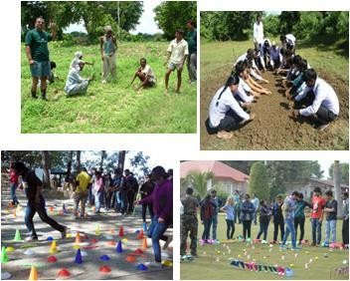
OUTDOOR/OUTBOUND EXPERIENTIAL LEARNING
Program Overview
The general philosophy that is the basis of our outdoor experiential program is taking the participants to an environment away from their typical day-day life and let them experience situations that they may be familiar with, be able to reflect on that experience and create new possibilities through new behaviour.
The activities are typically designed to improve leadership, communication skills, planning, change management, delegation, teamwork, and motivation. Strategies are formulated to deal with factors that hinder, and these strategies are then put to use in the activities that follow, to test their effectiveness.
Who will benefit from this program?
 New employees (orientation programs, boot camp)
 New to experience managers, Senior Executives, Team members
Key outcomes/benefits to participants:
 Situational Leadership, Leadership Styles, Servant-Leadership
 Working in Teams, Team Leadership, Team Bonding, Trust Building
 Goal setting to goal getting strategies
 Giving Feedback, Delegation Skills , Motivation Skills
 Creativity & Innovation , Problem Solving , Strategic Thinking
 Confidence Building, Decision Making, Personal Impact, Assertiveness Skills
Key Programs
 Grounded
 Boot Camp
 Leadership skills development
www.kaleidoscope.org.in

Slide 7

X-SELL : SALES PERFORMANCE PROGRAM
Program Overview
X-Sell Coaching Model (XCM) is designed to create & deploy customized sales enhancement programs, ensuring an effective transition from tradition or even basic consultative sales processes to eventually collaborative sales process, keeping the organizations unique business needs in mind.
Who will benefit from this program?
XCM-1: Front-line sales staff, telesales executives, customer service staff,
XCM-2: Mid-level managers, experienced managers or supervisors who want or need to brush up on their supervisory skills
Key outcomes/benefits to participants:
Sales as customer service, customer service as a sales technique
Types of sales reps
Building sub-conscious competence consciously
Moving from selling to “making the buy” happen
Probing, active and empathic listening
Selling as per customer’s personality type, thinking or decision patterns
Building trust & rapport
Key modules / Course overview
XCM-1 (1-2 days per module) |  | XCM-2 (1-2 days per module)
Sales essentials Selling basics | Buying vs selling | Types of sales reps | Personality types | Role of communication in sales | Essential negotiation skills Negotiation template | Building flexibility | Effective communication skills | Consultative Selling 4 quadrants of sales reps | Enhanced probing skills | Building powerful relationships | Connection strategy | Key Account Management Managing strategic accounts | Getting high-level buy-in | Building benchmarks | Client as partner
Telesales skills Role of voice in sales | Listening to sell better | Probing | Objection handling | Create engaging conversations | Rapport Building sub-conscious competence | Role of Trust | Handling objections | Moving from sell to buy | Champion mindset Sales goal setting to getting | Applying NLP techniques | Creating new patterns for sales success | Role of language in sales | Being in the “zone” | Advance negotiation skills | Handling difficult customers effectively | Leveraging data as a tool
Notes:
7

Slide 8

AT YOUR SERVICE - enhancing customer experience!
Program Overview
The program is a one-of-a-kind way to get customer service managers, supervisors and representatives up to speed on the best ways to handle difficult customers, deal with stress, motivate others, find new personnel and put that extra “something” into every customer contact!
The program introduces the basic concepts of customer service and dives into effective customer service techniques and practices.
Who will benefit from this program?
Customer service managers, Call center managers, Supervisors, Team Leaders
Customer service representatives, Lead Reps and specialists, Anyone has regular customer contact and is responsible for taking care of customers’ orders, requests or problems
Key outcomes/benefits to participants:
Know the essential factors that are important in customer service
Develop a customer-friendly approach that is right for your business
Do's and don'ts when dealing with customers, and the benefits of providing great customer service
Learn standards of excellence in customer service
Communicate effectively, learn different styles of communication and non-verbal cues in communication.
Take ownership, resolve problems and empathise to gain trust.
The secrets to staying cool when customers get hot
How to meet the unique challenges of customer service management
How to turn complaints into profits
Key modules / Course overview
Customer types Leveraging communication to deliver exceptional customer experience How to build rapport & win customer’s trust | Listening strategies to gain information and create conversational bridges Empathy & probing effectively Verbal and nonverbal language to create consistent, coherent and targeted messages | Assessing conversational style preferences, strengths and weaknesses and flexibility Interpersonal skills to build solid relationships Handling customer service stress – the 15 min mini spa
Mode: Classroom, Outdoor, Virtual, 1-1 or focus group reinforcement
Duration: 2-3 days
Notes:
8

Slide 9
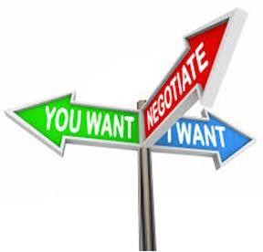
MASTERING THE ART OF NEGOTIATION to win & close deals!
Program Overview
This workshop is for organizations or associations that want to maximize their training investment and ensure that participants are ready to use their new negotiating skills as soon as they leave the program. In this compressed, highly interactive program, participants will:
Learn how to manage shared, differing, and conflicting interests
Discover their strengths and weaknesses as a negotiator
Acquire a systematic framework for handling deals and disputes
Who will benefit from this program?
 Employees who negotiate with other employees or external parties and want to learn how to work better with others
 Professionals at all levels benefit from this program.
Key outcomes/benefits to participants:
 Basic negotiation principles, including BATNA, WATNA, WAP, and the ZOPA
 Learn a proven and powerful negotiating process and methodology
 Learn the three key factors that influence every negotiation
 Learn how information, time, and personal power can influence every negotiation
 Determine participant personality types and corresponding negotiating styles
Key modules / Course overview
THE ART OF NEGOTIATION Negotiation as a Basic Life Skill | Self-Assessment of Negotiation Practices | Skills you will need | PLANNING FOR NEGOTIATIONS Getting the Facts | Setting Negotiating Objectives | Defining the Settlement Range | AT THE BARGAINING TABLE Extracting and Granting Concessions | Testing and Maintaining Credibility | Analysis of Role-Play Results
USING POWER AND APPLYING PRESSURE Using Power Tactics | Resisting Intimidation and Pressure | Fighting Dirty Tactics | REACHING AGREEMENT Co-operative Modes of Negotiation | Analysis of Role-Play Results | Breaking an Impasse | THE WINNING NEGOTIATOR Negotiations | Assessing Your Negotiation Situation | Developing a Negotiation Improvement Plan
Mode: Classroom, Outdoor
Duration: 1-2 days
www.kaleidoscope.org.in

Slide 10

THE ART OF THE PITCH - effective presentation skills
Program Overview
The Effective Presentation Skills (EPS) is designed to develop specific verbal and non-verbal skills necessary for public speaking, whether it involves delivering a business presentation, talking to their team convincingly, or making a sales presentation.
The program is mostly conducted in real-time theatre scenarios and the participants are led by an experienced performance coach at each stage.
Who will benefit from this program?
All employees
Key outcomes/benefits to participants:
Develop a more persuasive and impressive speaking style
Control your space and presence to build rapport and influence your audience
Use pace and structure more powerfully
Fine tune delivery to create maximum impact
Understand how to overcome the fear of public speaking
Use language more creatively
Key modules / Course overview
Presentation content Honing skills to communicate effectively Achieving the objective – Not just delivering content Making an impact! | Stage Presence Speak with confidence, persuasion and influence Understanding the Audience & playing to it's preferences Strong Opening, Strong Close | Gaining Agreement & Commitment Planning & Preparation Contingency Planning Using NLP techniques
Mode: Classroom
Duration: 1 day
Notes:
10

Slide 11

ACTivate
… theatre based learning
Program Overview
ACTivate is an impactful and highly innovate way to convey key messages to the audience, using Theatre, Creative Movement, Storytelling and skits.
An experienced facilitator and performance coach guides the audience through specific scenario based performances, which involve concepts that
impact the audience’s life on a professional as well as personal level. These includes empathy, leadership, team skills, leveraging diversity,
innovativeness, creativity, sub-conscious behaviour, limiting beliefs, women leadership and many more.
The programs have found significant acceptance from participants, due to its mode of engagement, simplicity and impactful takeaways
Who will benefit from this program?
 All employees
Approach & modes of delivery:
 Drama/Theatre by professional actors, props, stage
 Creative Movement
 Movie scenes / video logs
Improve
 Story Telling: Engaging leadership through stories
Mode: Classroom
Duration: 0.5 to 1 day
www.kaleidoscope.org.in

Slide 12

TIE-BRAKE
…sports based learning
Program Overview
•
Are you a sprinter or a marathoner at work and at home?
•
What gives you a boost… endurance or explosiveness?
•
Do you prefer doing things that involve fine or gross motor skills?
TIE-BRAKER
is one of our flagship one of a kind programs, that, as the name suggests, is about giving
corporate employees, business owners, a “BREAK” and get to play a very stimulating set of games, through
which specific outcomes or goals can be addressed!
NOT to be mistaken for typical team building games!
The program features a pre-assessment, in-game observation, staged situations, post-assessment and
experience sharing format. Participants are continuously engrossed in facing situations that they typically
find uncomfortable handling, thereby, challenging them to make decisions that stimulate new responses.
Who will benefit from this program?
 All employees, business owners, entrepreneurs, academies
Key modules / Course overview
Key outcomes/benefits to participants:
 Take ownership, resolve problems and empathize to gain trust
 Leadership skills
 Gender sensitivity
 Negotiation
 How to stay in the “ZONE”
 Collaboration
 Leveraging diversity
 Presentation skills
 Discover your “sport” style at work, home and in general!
Empathy
 Positive thinking
 Self esteem
 Increased confidence while communicating with multiple stakeholders
 Goal orientation
 Strategy & Planning
 Situational
 Building your individual roadmap through SWOTAF
leadership
 Trust
 Time management
 Understanding, challenging & overcoming Limiting Belief
 Ethics
Mode: Classroom, Outdoor
Duration: 1 day
www.kaleidoscope.org.in

Slide 13

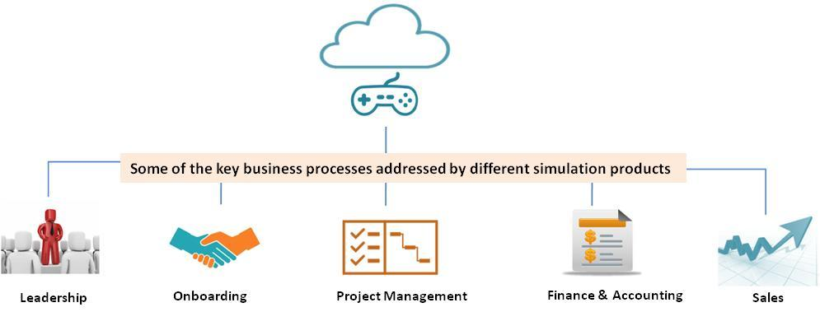
GAMIFIED SIMULATION BASED PROGRAMS
Program Overview
The immersive learning environments involve high-end video game technologies that can both replicate and far extend physical classrooms,
giving learners an opportunity to learn in a safe environment, to practice and learn from their mistakes.
Who will benefit from this program?
 Based on the module or program objective, the participant profile will vary. The simulation programs have provided effective outcomes to new
hires, managers, senior management, entrepreneurs as well as students.
Key outcomes/benefits to participants:
 Throws the learner straight into the middle of the action
 Fully immersive, game-based and experiential design
 Timed decision-making activities
 Strong storyboarding and scripting
 Real time game-style progress stats and points
 Formative feedback at each decision level
 mpactful
Key modules / Course overview
−
Situational Leadership
−
Leadership styles
−
New manager orientation
−
Project management
−
Sales & customer service
−
Finance for non-finance managers
−
Project management for non project managers
Mode: Classroom, Virtual, Classroom + Online
Duration: 1 day per module
www.kaleidoscope.org.in

Slide 14
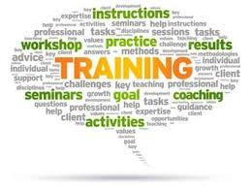
TRAIN THE TRAINER PROGRAM
Program Overview
The train the trainer model enables an experienced trainer to guide a less experienced trainer or instructor to deliver training programs, workshop and
seminars. It is also a program which increases the skill set from concept building to delivery of an individual trainer. It covers a wide range of skills from
need analysis, to content building, delivery, measuring the target audience and to the final level of feedback analysis and performance evaluation.
Who will benefit from this program?
 In-house trainers (new/experienced), aspiring SMEs, managers, supervisors
 Managers or supervisors who wish to brush up their current skills as trainers
Key outcomes/benefits to participants:
 Create a conducive training environment, using humor, fun and delivery
 Understand the background and theory behind the content
 Team analysis and effective group development techniques
 Psychological knowledge and reading the mind of the trainees
 People's problem – (Stress, conflict), identifying and solving
 Effectively communicate key messages related to course materials
 Understand and utilize interactive/experiential delivery techniques properly
 Feel comfortable managing touchy topics related to course material
Key modules / Course overview
Course curriculum / content
Audience Mindset
Presentation skills & delivery
−
Preparation | timely delivery
−
Psychology | expectations | TNA
−
Questioning: probing, handling people
−
Design | customization | branding
−
Past experience | profiling
−
Verbal ability: tone, speed, tempo
−
Sequence | activity guide
−
Content flow: design, lucidity
Mode: Classroom, Outdoor, Virtual, 1-1 or focus group reinforcement
Duration: 3-4 days; 3-4 weeks for entire program
www.kaleidoscope.org.in

Slide 15

INTERVIEWING SKILLS PROGRAM
Program Overview
The goal of the program is to equip interviewers with the skills to conduct effective & efficient interviews before making the right selection,
while still staying “human” in the process.
Who will benefit from this program?
 HR managers, Operations/ Sales/ Technical/Non-Technical managers & supervisors, business unit heads, contracted or outsourced
recruiters
Key outcomes/benefits to participants:
 Understand the interviewee, interviewer & interview process
 Discover strengths and weaknesses as an interviewer
 Conduct interviews professionally
 Create interview based goals & effective post-interview deliverables/handovers
 Know what to include, avoid & reinforce during interviews
 Explore ways to deal with difficult interviews
 Know & apply different questioning, probing styles
 Understand seen & unseen communication during interviews
 Apply effective post-interview follow up techniques
Key modules / Course overview
−
Creating an interview GOAL
−
The Interview FUNNEL
−
Role of empathy in the interview process
−
The interview process
−
Different interviewing techniques
−
Effective probing, Questioning styles
−
Creating a job description –
−
STAR method
−
Personal conduct: How to “sell” as an
going beyond the resume
−
Planning & Preparing for the interview
interviewer
−
Types of interviews
−
−
Facilitate Open communication
Mode: Classroom
Duration: 1-2 days
www.kaleidoscope.org.in

Slide 16
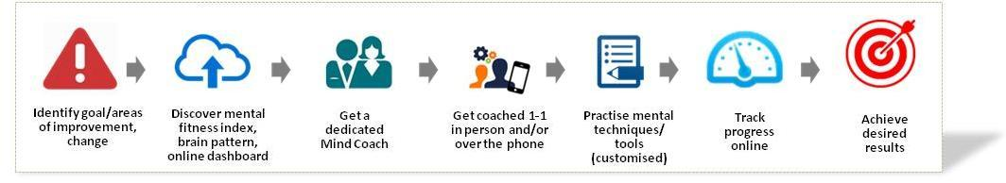
COACHING FOR PERFORMANCE
Program Overview
The 1-1 & focus group based coaching program empowers individuals to solve specific problems, or reach a specific goals in an easy, effective
manner, and is available on demand!
Our panel of certified executive coaches and trainers have all had frontline corporate experience prior to working in the personal development
industry. They therefore have a clear understanding of the needs and issues facing the executives and employees that they work with.
Who will benefit from this program?
 Individuals with specific performance issues or goals, team members, teams
How does it work?
Typical issues & goals addressed through the coaching:
Increase self-awareness and self-confidence
Email/ activity compulsion
Personal Wellness
Leverage strengths and talents for greater success
Frustrated with results/ conflicts/ roles
 Imbalance in personal-work life
Experience new approaches to build business
Underprepared for challenges
 Lack of time for new initiatives
Adopt powerful success rituals
Unable to align others to vision
 Mental fatigue
Lack of clarity in decisions
 Unable to maintain healthy lifestyle
 Impact in social relationships
Programs
Coach and mentor supervision | Evaluation of coaching | Real-time coaching support | Coaching & Mentoring set-up in corporate houses
www.kaleidoscope.org.in

Slide 17

GENDER SENSITIVE WORKPLACE
Program Overview
The
GSW program is primarily focused on setting up a Sexual Harassment & Complaints Cell at organizations and conducting an awareness program
to all employees of the organization to recognize and ensure the safety as well as proper addressing of any gender related grievance of its
employees in a manner stipulated by the Supreme
Who will benefit from this program?
 All employees
Key outcomes/benefits to participants:
 Meet the requirement of the Supreme Court
 Make it clear that this is a workplace where harassment will not be tolerated.
 Provide education and information about harassment to all staff on a regular basis.
 Develop an anti-harassment policy together with employees, managers, and union representatives.
 Ensure all managers and supervisors understand their responsibility to provide a harassment-free work environment.
 Ensure that all employees understand the policy and procedures for dealing with harassment - new and long-term
employees alike
Key modules / Course overview
−
GSW – introduction
−
Setting up an ICC/SHCC
−
Understanding the ACT
−
The complaint process
−
Case discussions
−
Employer’s responsibility
Mode: Classroom
Duration: 1 day
www.kaleidoscope.org.in

